Slide 1
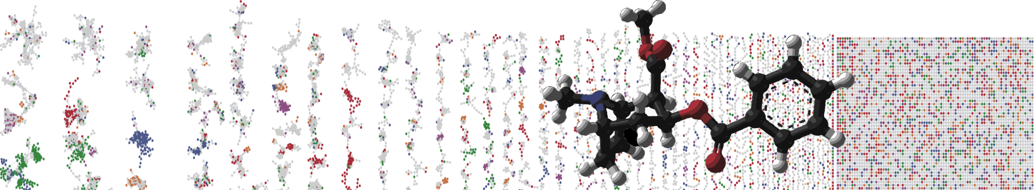


Feature-Based Molecular Networking
for Advanced Metabolomics
Data Analysis with GNPS
Louis-Felix Nothias
University of California - San Diego
Slides by
Louis Felix Nothias

Slide 2
Summary FBMN
Intro: Molecular networking
A New Method for Molecular Networking
Spectral artefacts
Isomers
Quantification
Conclusion and Discussions

Slide 3
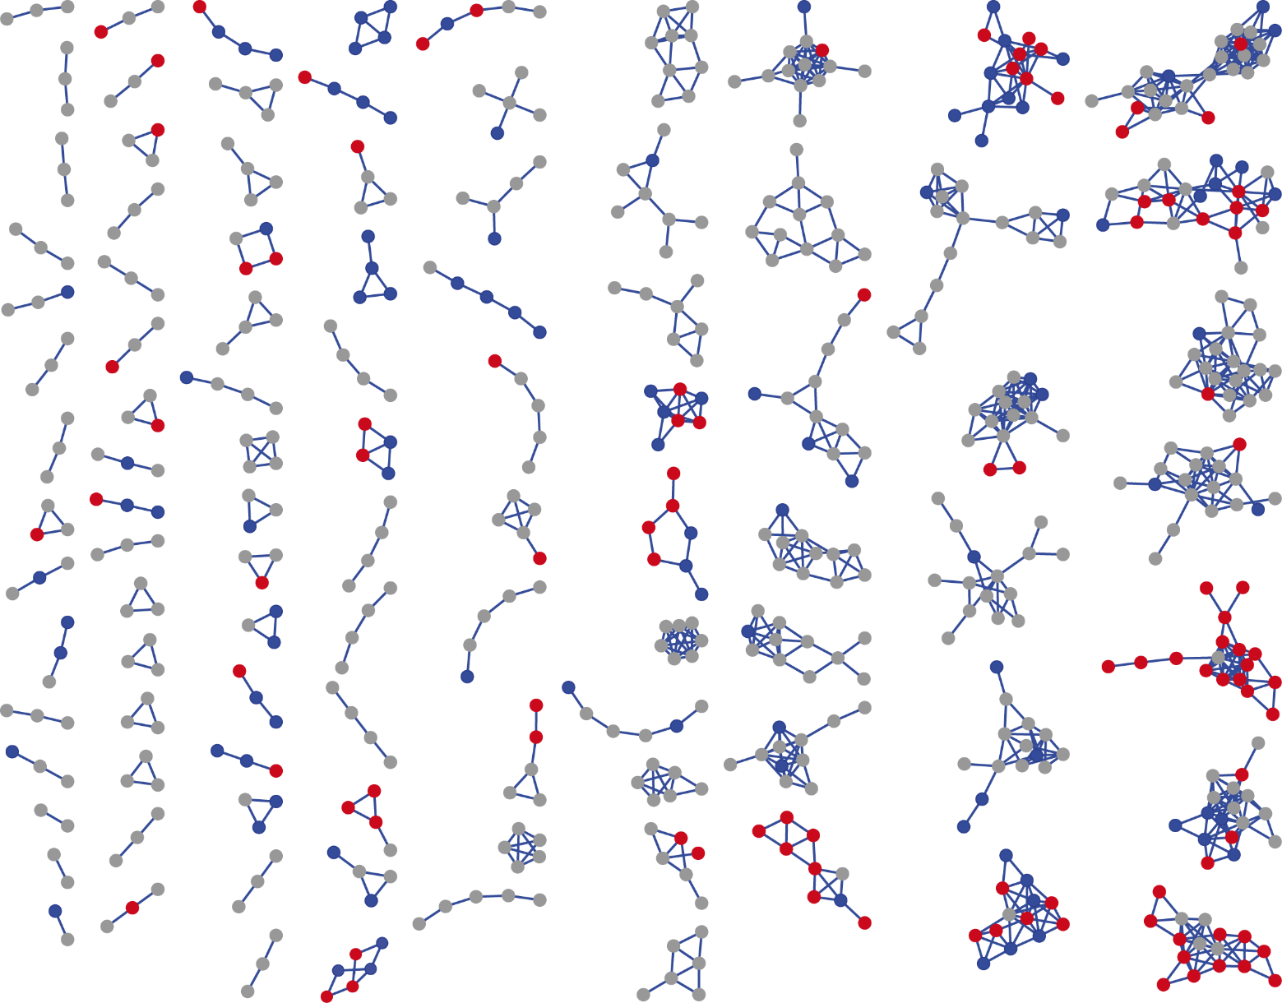
Molecular Networking
Polyketides
Library Hit B
Diterpenes
Macrolides
Wang et al. Nat. Biotech. 2016 Aug 9;34(8):828-837.
Slide with D. Petras.

Slide 4
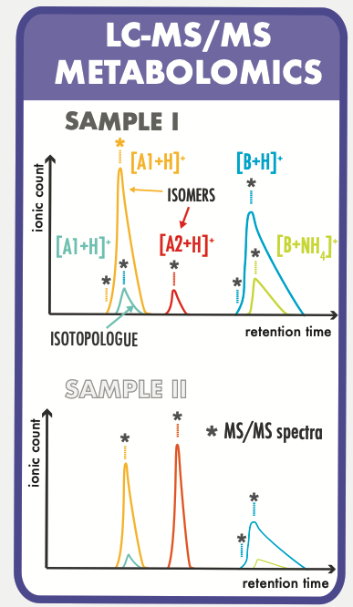
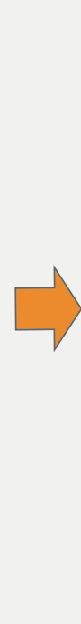
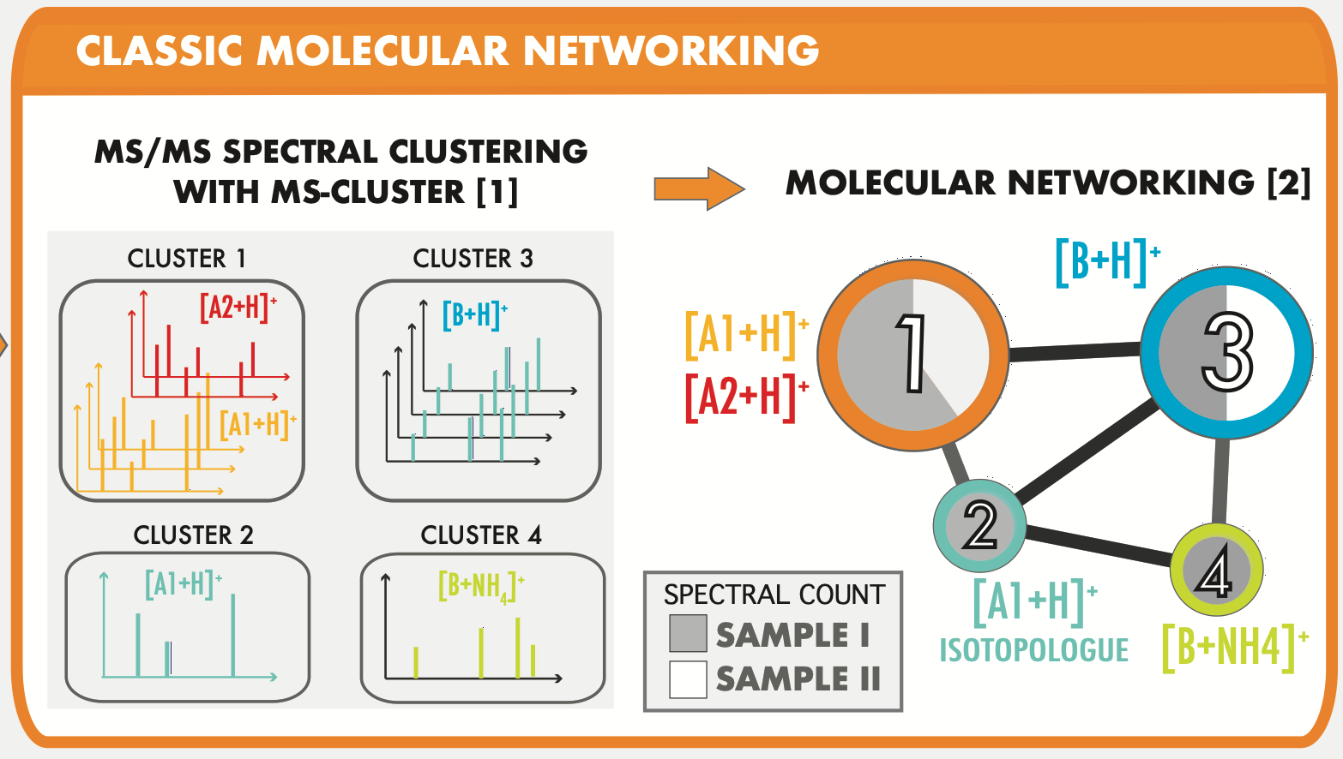
Classic Molecular Networking

Slide 5
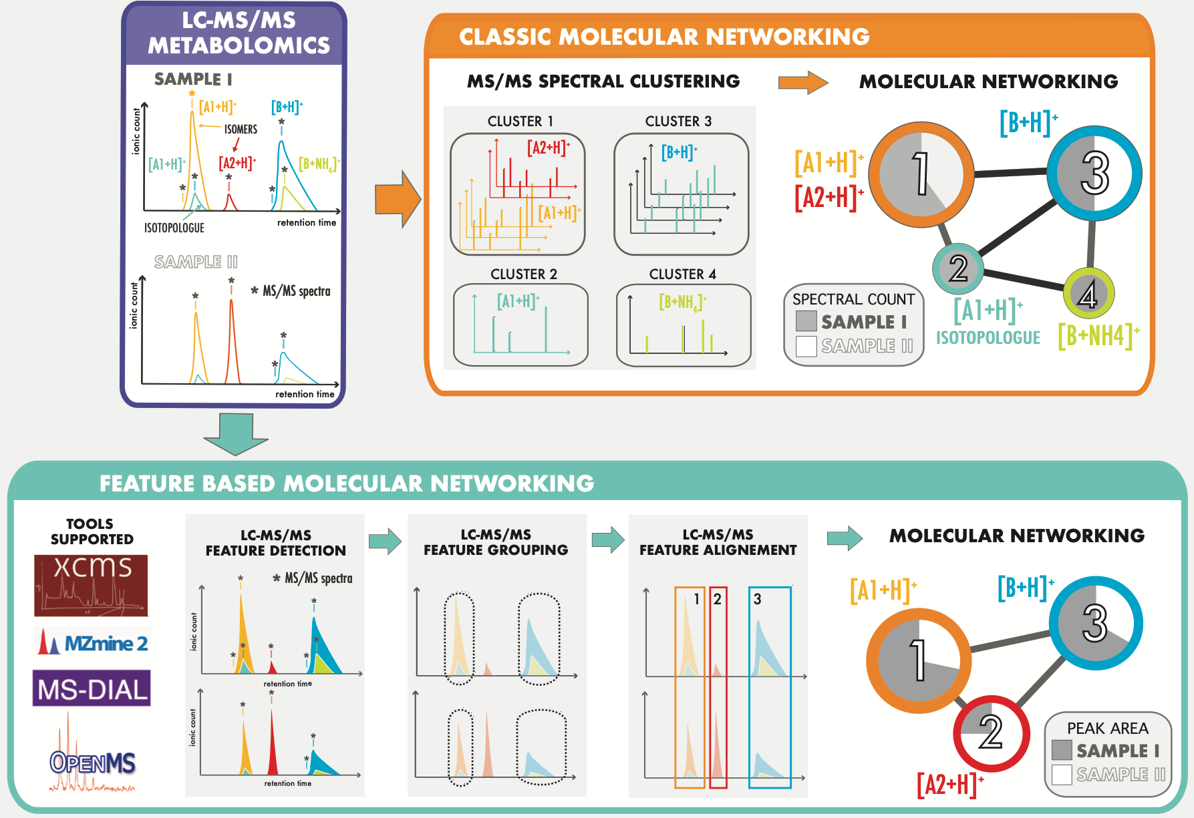
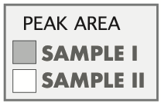
Two Methods for M-Networking

Slide 6
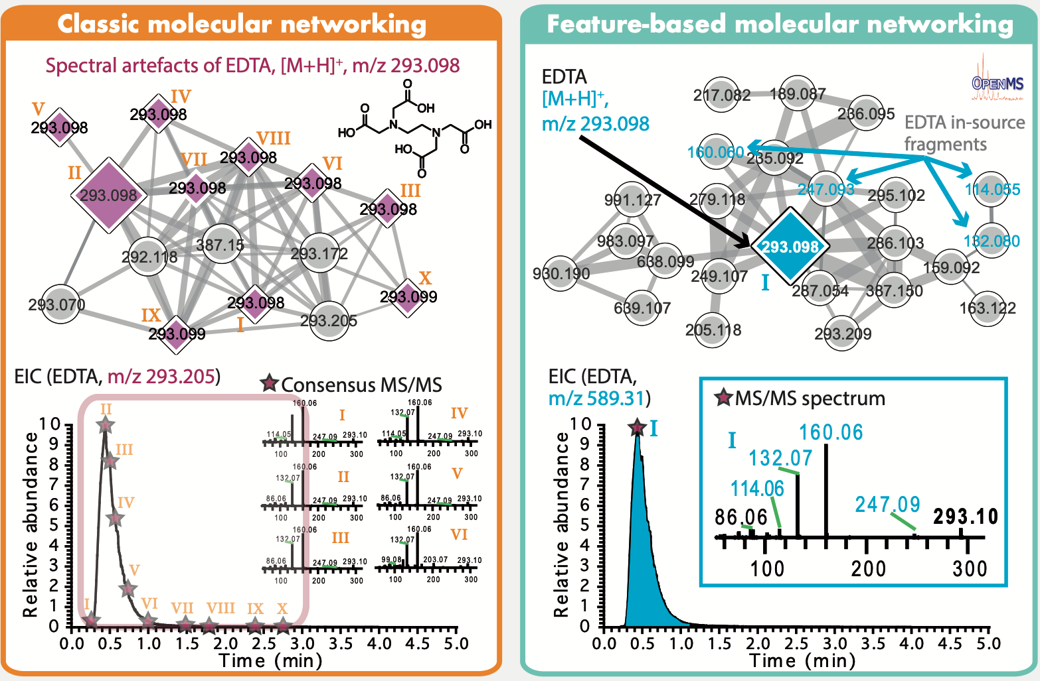
Dealing with Artefacts with FBMN

Slide 7
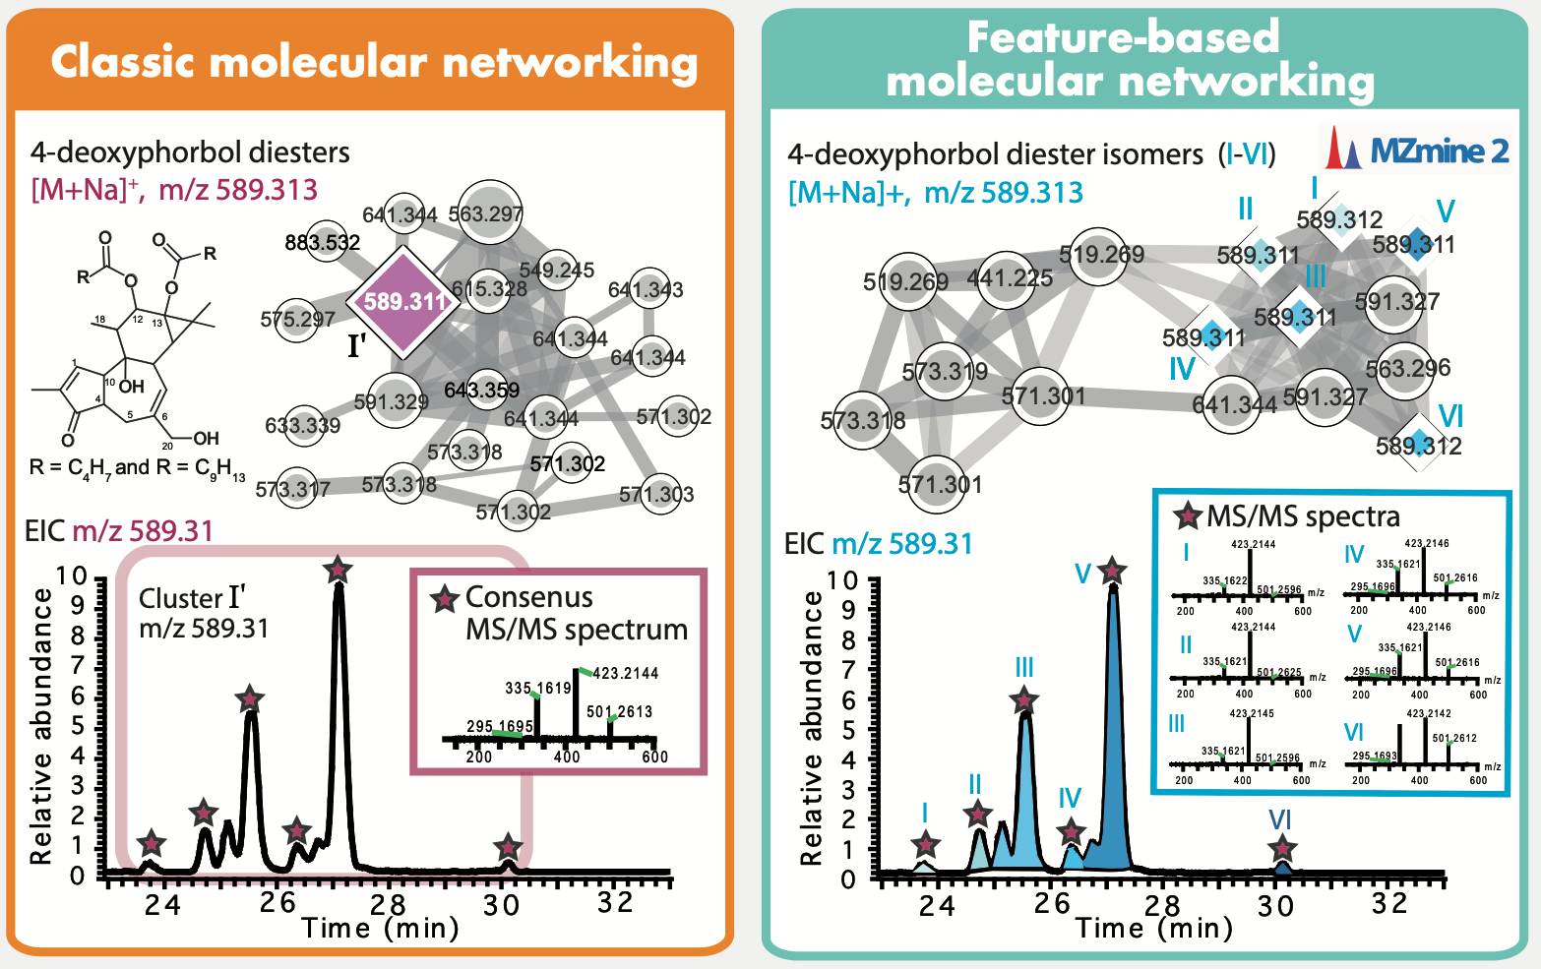
Dealing with Artefacts with FBMN

Slide 8
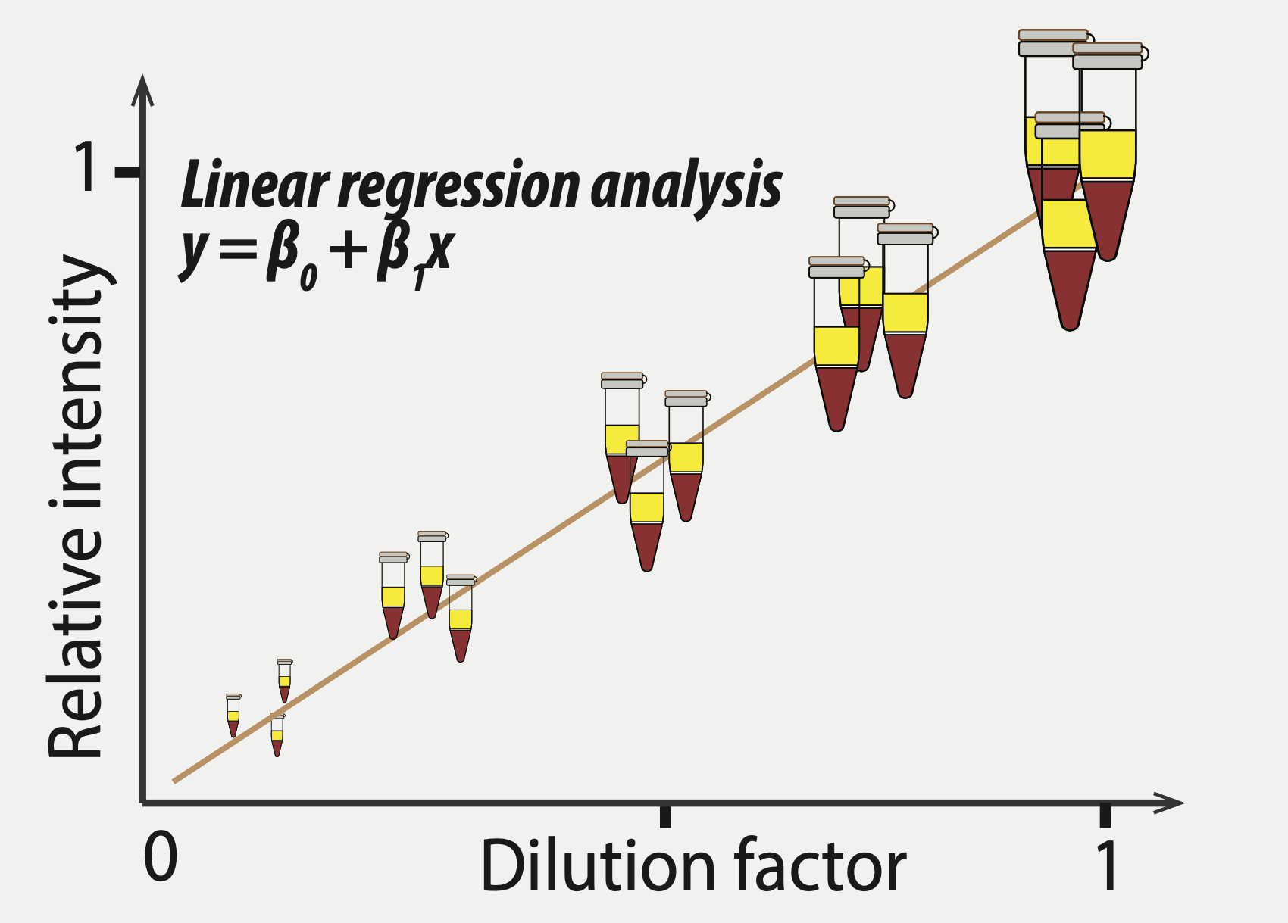
Molecular Networking: Quantification
Evalution using NIST 1950 SRM, 5 dilutions, 150 compounds annotated.

Slide 9
Molecular Networking: Quantification

Slide 10
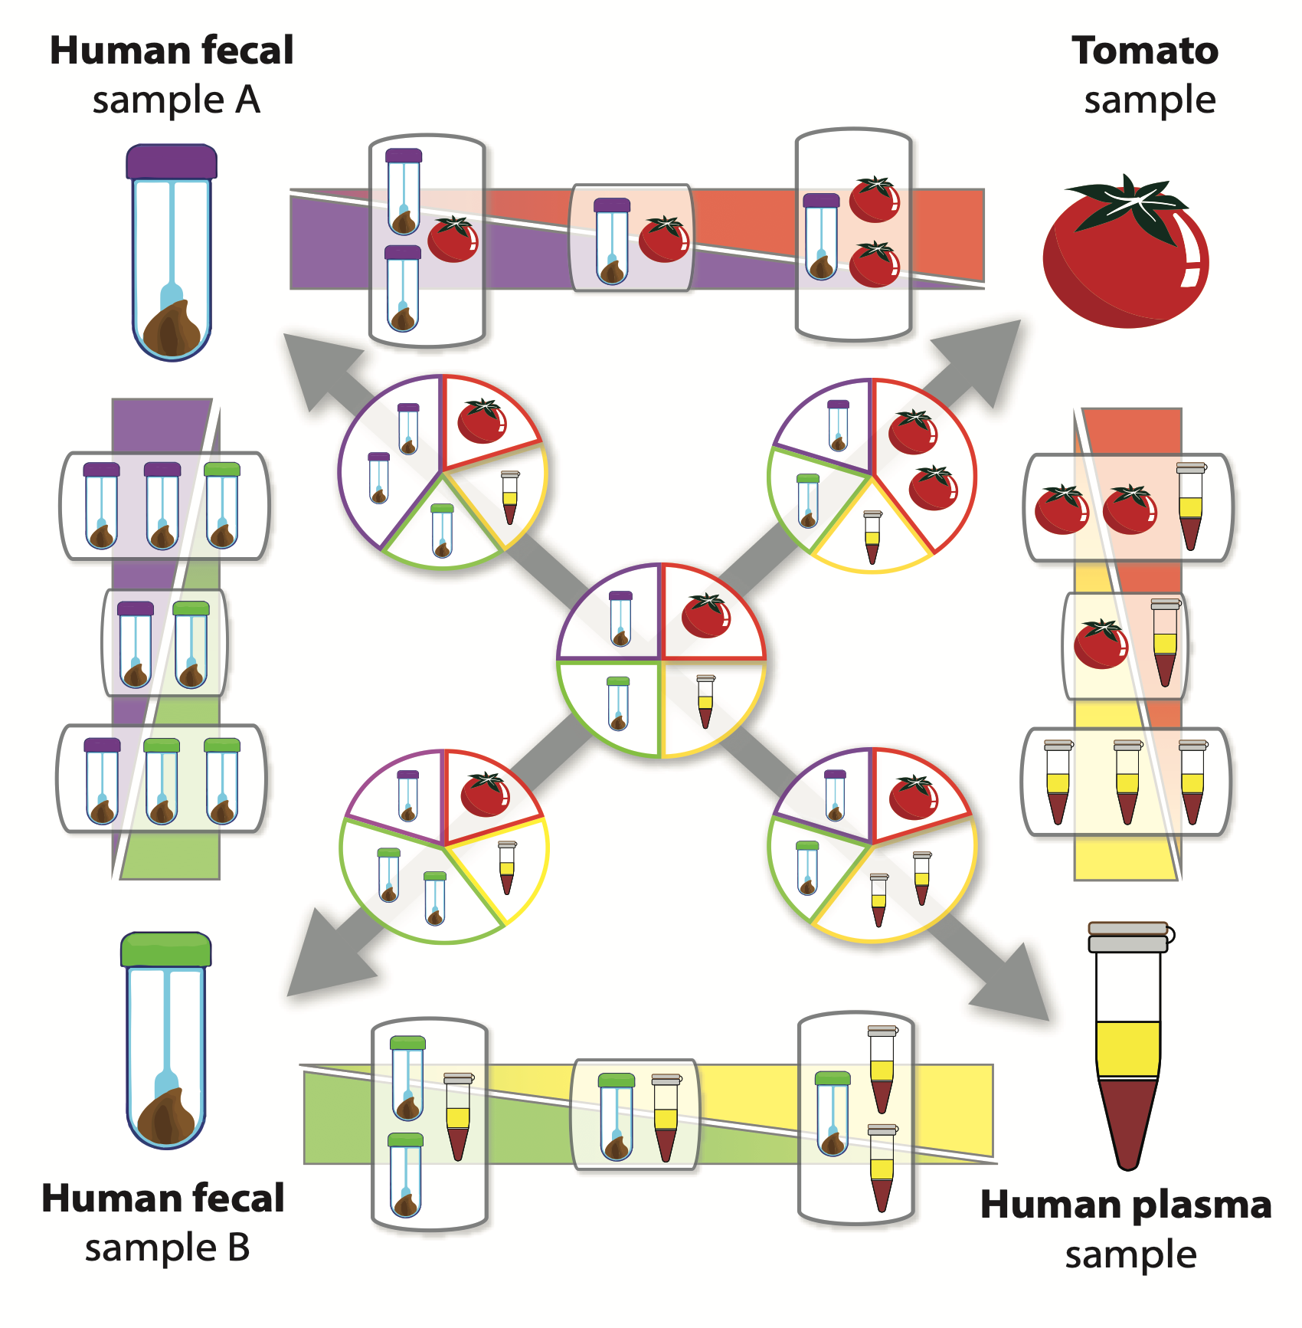
Gradient Benchmark

Slide 11
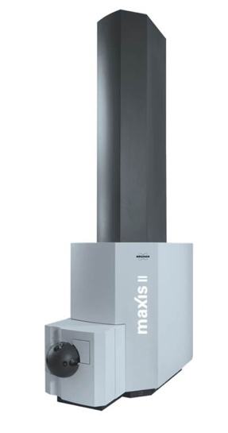
Gradient Benchmark: Classic MN
Samples analyzed by LC-MS/MS (DDA mode) on QTOF instrument (maXis II, Bruker Mass Spectrometry, C₁₈ column)

Slide 12
Gradient Benchmark: FBMN
Samples analyzed by LC-MS/MS (DDA mode) on QTOF instrument (maXis II, Bruker Mass Spectrometry, C₁₈ column)

Slide 13
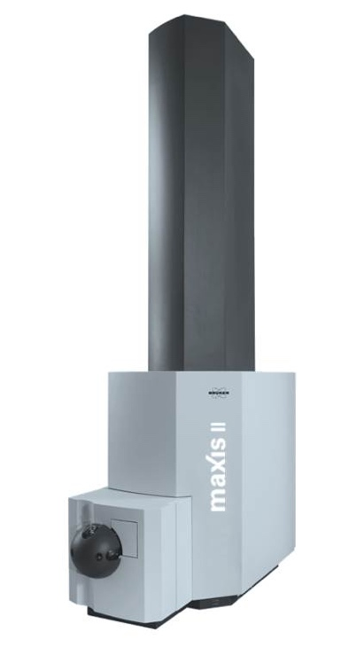
Gradient Benchmark: Meta-Analysis

Slide 14

Gradient Benchmark: Meta-Analysis
Meta-analysis of three experiments (QTOF, classic MN)

Slide 15
Gradient Benchmark: Meta-Analysis
Meta-analysis of three experiments (QTOF, classic MN)

Slide 16
Gradient Benchmark: Meta-Analysis
CLASSIC MN
Feature-Based MN
CONS
PRO
Limited quantitation
Various artefacts
Optimal quantitation
Isomers and artefacts
PRO
CONS
Easy to use
Meta-analysis
Requires an advance training
No meta-analysis
PRELIMINARY ANALYSIS
META-ANALYSIS
ADVANCED
ANALYSIS
SINGLE DATASET

Slide 17
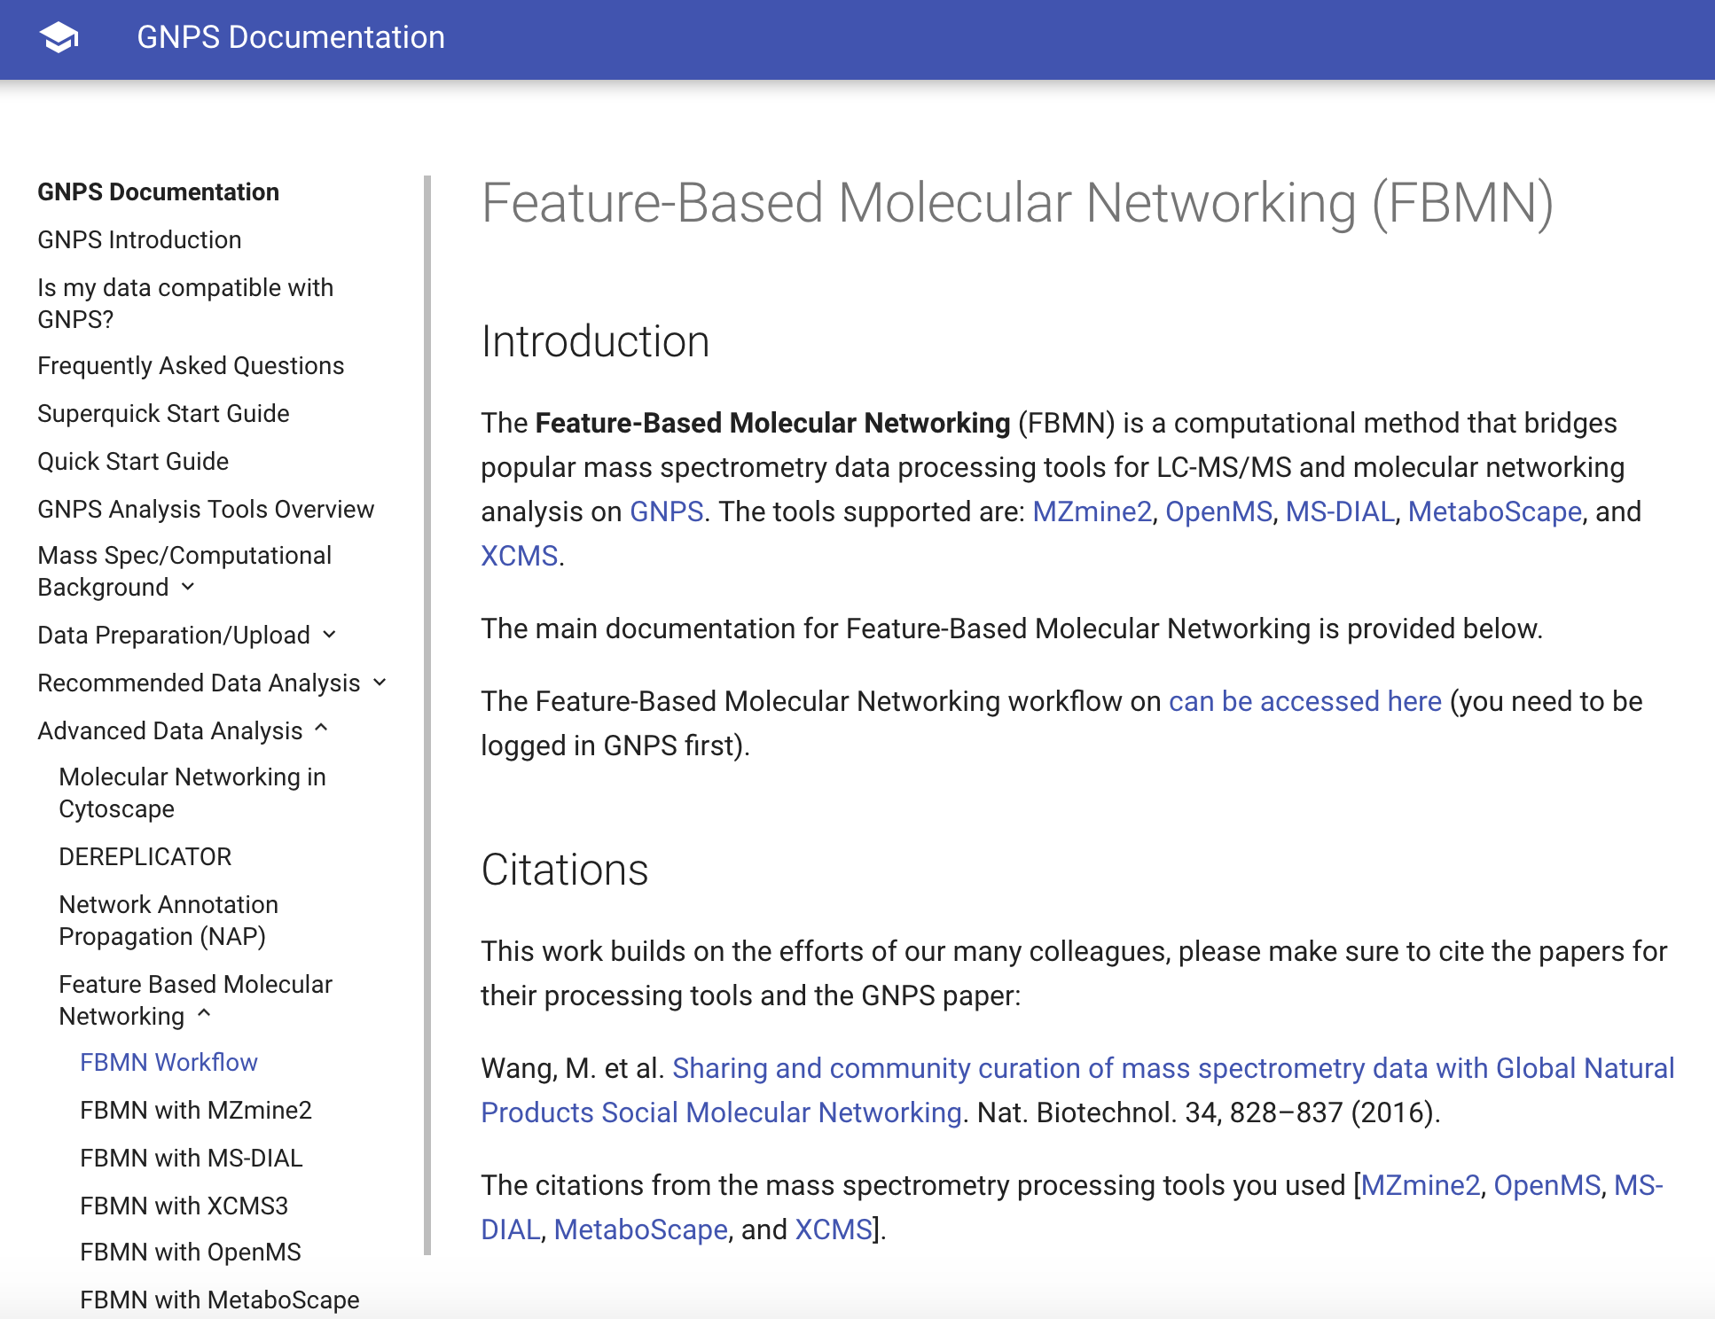
Feature-Based MN Documentation
Access the documentation here: https://ccms-ucsd.github.io/GNPSDocumentation/featurebasedmolecularnetworking//

Slide 18
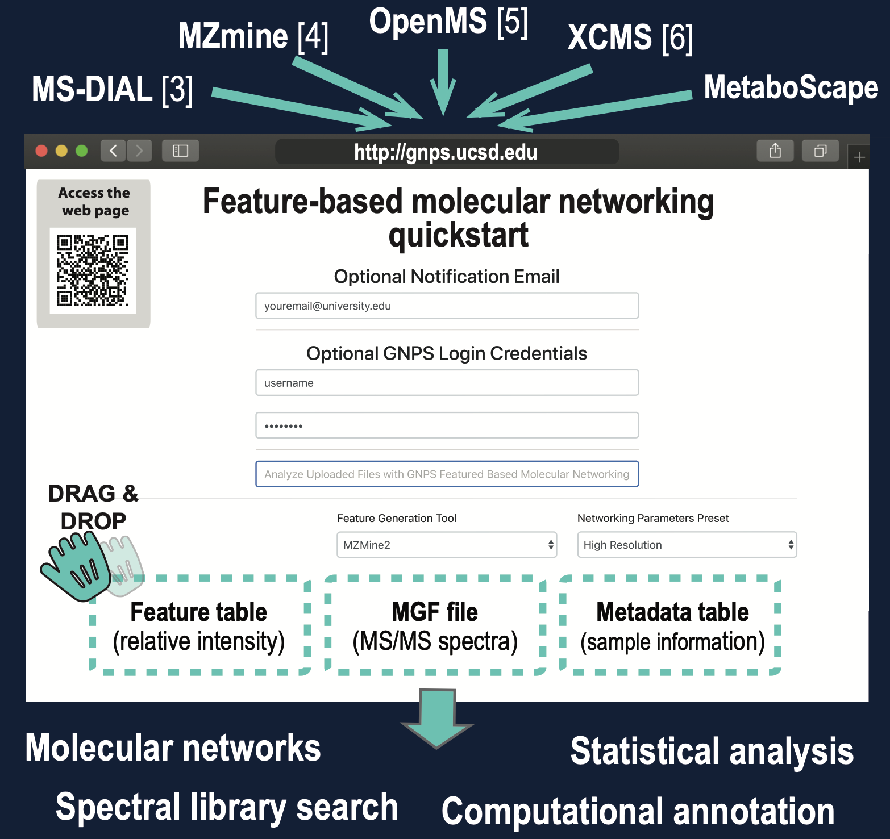
Feature-Based MN Quick Start
Access the page here: http://dorresteinappshub.ucsd.edu:5050/featurebasednetworking
Download these files at spectral_data.mgf feature_table.csv and metadata.txt
See the result of one example job here.

Slide 19

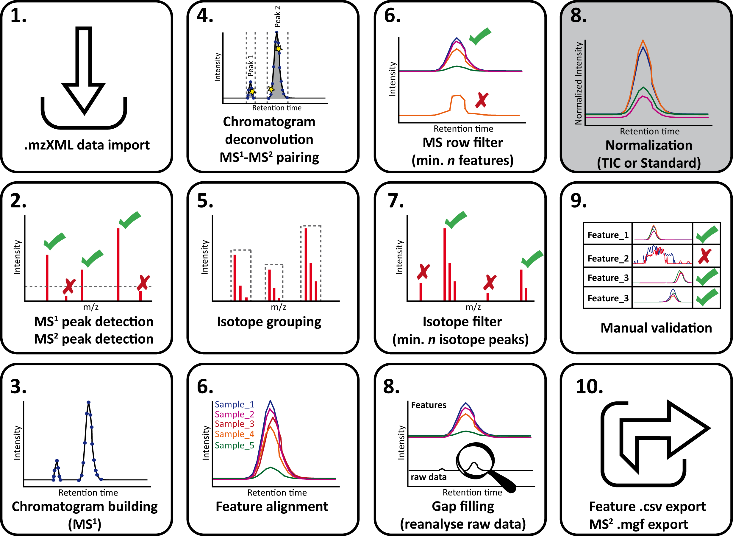
Feature-Based MN with
Access the video tutorial :
https://www.youtube.com/watch?v=5jjMllbwD-U&list=PL4L2Xw5k8ITzd9hx5XIP94vFPxj1sSafB

Slide 20
Thank you

